Slide 1
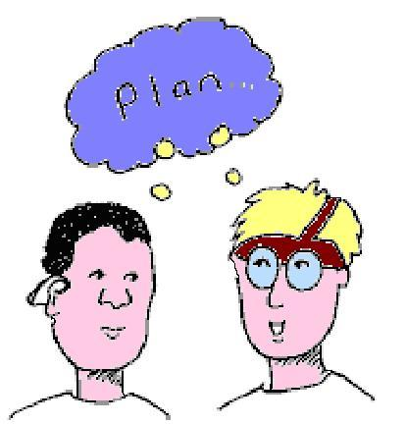
Psychological and Social Science
Week 8
Person centered care improvement planning

Slide 2
Values of Care
To understand Person centred Care you must understand the Values of Care
If you were a Service User, how would you want to be treated?

Slide 3
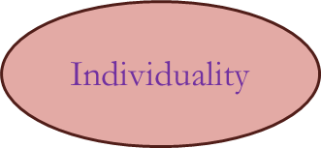
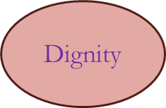
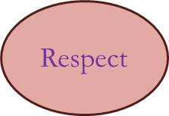
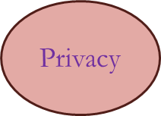
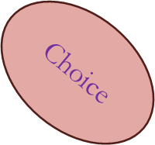
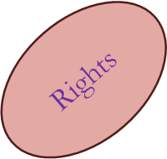
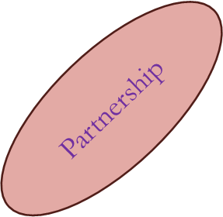
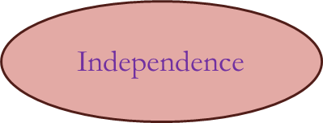
Understanding the principles of care
Values

Slide 4
Statements that define Values
Things that are important to people or a person
A set of thoughts that a person abides to and practices
How a person views the world and how it influences their behaviour towards others
Things that people do to help them get on with others.

Slide 5
Values of Care
Individuality
Independence
Choice
Privacy
Dignity and respect
Rights
Equality and inclusion
Diversity and culture

Slide 6
Person centred
approach

Slide 7
Person Centred Planning.
Definition
Person- centred planning is a process for continual listening and learning, focused on what is important to someone now and for the future, and acting upon this in alliance with family and friends.

Slide 8
Person centred care is built round:
Four essential elements:
V – Values.
I – individual
P – Perspective
S – Social environment.

Slide 9
V – A value base that asserts the absolute values of all human lives regardless of age or cognitive ability.
I – An individualised approach, recognising uniqueness.
P – Understanding the world from the perspective of the service user.
S – Providing a social environment that supports psychological needs.

Slide 10

Individualised care
Care plans should meet the individuals whole needs with regards to daily living, Social needs and promoting independence.
Care plans should be regularly reviewed.
Service users should have their personal possessions for everyday use.

Slide 11
Individualised care
Individual preferences known to staff.
Life history known to all staff
Are there a range of activities available to meet the needs and abilities of the service users?

Slide 12
P.C.P. is about
Listening and learning –
Used to understand a persons capabilities and choice
Important to focus on capabilities not disabilities
Working in partnership with others e.g. Advocates multidisciplinary team

Slide 13
P.C.P. is a
Basis for problem solving and negotiation to mobilise the resources necessary to pursue the persons aspirations.

Slide 14
P.C.P.
Is about putting the person at the centre of the planning process

Slide 15
Listen
Checking
Planning
Implementing

Slide 16
What is a Person Centred plan
An in-depth plan, drawing together the VIPS elements.
Values, individual, personal preferences and social aspects.

Slide 17
Putting person centred values into practice
How do we put person centered planning into practice once a residents values have been identified?

Slide 18
putting Pcp into practice
Listen to their requirements
Including family and friends
meeting cultural requirements
Knowledge of future requirements
Working in partnership with other professionals
E.G Advocacy
Inclusion in activities
Respecting their diversity
Giving choice
Reviewing requirements and adapting

Slide 19
How to put pcp into practice
Ensures a Person centred approach to its care delivery
Places the needs, wishes, preferences and decisions of people who use our services at the centre of the assessment, planning and delivery of care, treatment and support
Completes and reviews person centred care plans
Ensures our staff promote and respect the residents privacy, dignity, independence and human rights
Listens to the residents views and experience of

